Slide 1

FS Greeter Training

Slide 2
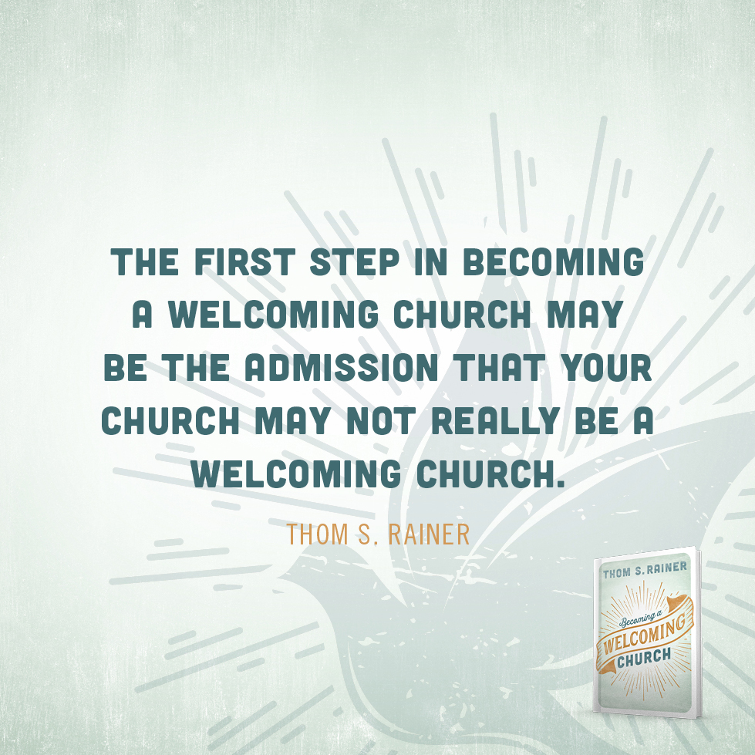

Slide 3
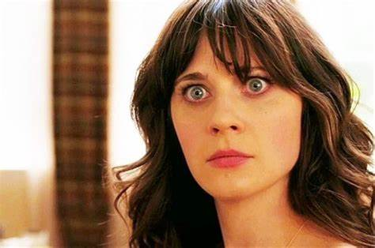
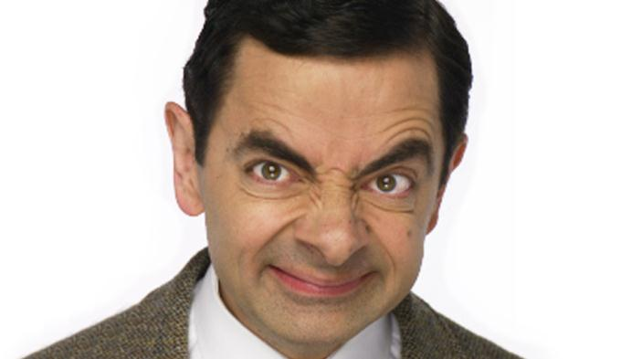
A greeter shook my hand and said, “You are a big man. How much do you weigh, anyway?” –James Ost
At one time we had a greeter who would stand at the door of the sanctuary and welcome people. This man stood 6-feet, 2-inches tall and weighed a good 450 pounds. He has been a part of the church for years and loves to give out hugs to friends and members of his small group.
But one Sunday he decided to greet a first-time visitor who held out her hand for a nice shake and a bulletin. He responded by telling her that our church doesn’t do handshakes because we are “The Little Love Church” and we do hugs. He then proceeded to hug her, pulling her close and making far too much physical contact. Bless her heart she stayed for the whole service. –John Mark McKanna
I went to visit a very well known megachurch and arrived about an hour before their service started. There weren’t any ushers or welcoming team in their spots yet, but that didn’t matter to me.
I went to the bathrooms in their lobby area and as soon as I came out the person who missed welcoming me was right there waiting at the bathroom door. She had been waiting for me to come out of the bathroom! –Caleb Hayworth

Slide 4
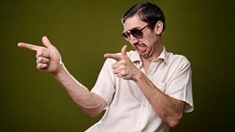
Scenario 1:
An unfriendly, unpleasant person with breath that smells like onion soup and hair that looks like a squirrel’s nest is standing at the door ignoring you because he or she is too busy talking to friends. You don’t know where the restrooms are or where your children should go for children’s church because there was no one to show you around. Therefore, as a result, you’re late for the service and enter after praise and worship has already begun. People are milling about and talking which is distracting and you can’t even choose a seat until everyone makes their way back to theirs. At this point you’re too embarrassed to go up front for a seat, so you sit in the back.

Slide 5

Scenario 2: You arrive and are immediately greeted by a well groomed, friendly, pleasant person waiting by the door. You are enthusiastically welcomed with a firm handshake, asked your name, given a visitors packet, and offered a tour of the church especially to the donuts and coffee. You are introduced, by name, to one of the pastoral staff, who happens to be standing nearby. If you have children, you are escorted to the children’s ministry and introduced to the children’s church leader. You enter the sanctuary before the service begins, and are warmly greeted by members of the congregation and asked to sit with them.
In which of these scenarios would you be likely to return?

Slide 6
“As a visitor, I want at least one person to shake my hand, tell me their name, ask for my name, and pretty much feign interest in getting to know me.”

Slide 7
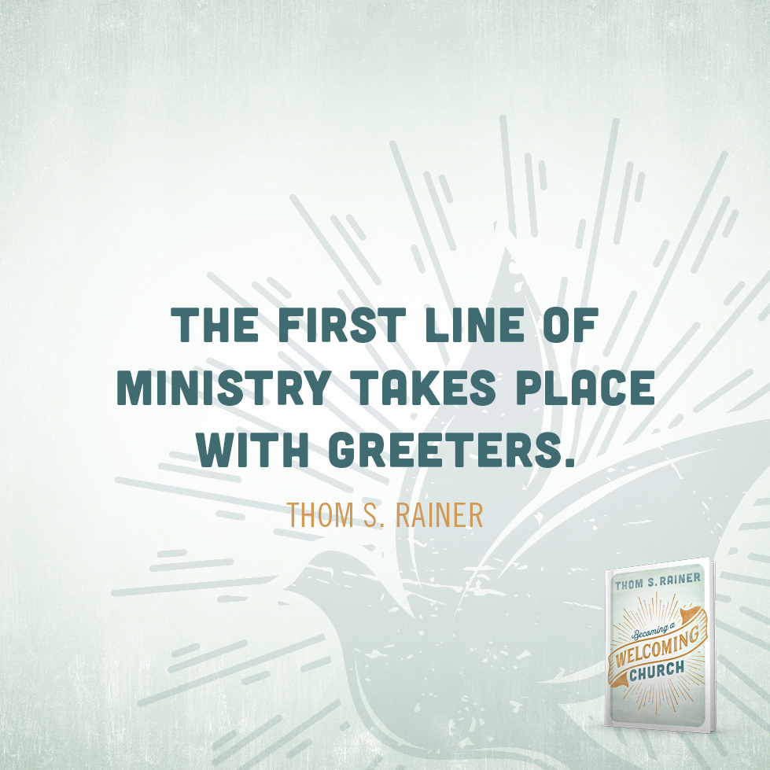

Slide 8
THE THREEFOLD PURPOSE FOR THE WELCOME MINISTRY
To Welcome Visitors.
  First impressions are lasting ones! We want to give a great first impression by welcoming our visitors with friendly and helpful greeters.
To Welcome Regular Attendees.
We want to let our church family know that we’re glad they’re here by greeting them with a smile each time they arrive.
To Offer Information.
Please be prepared to give directions to places such as the restrooms or the nursery and answer basic questions.

Slide 9
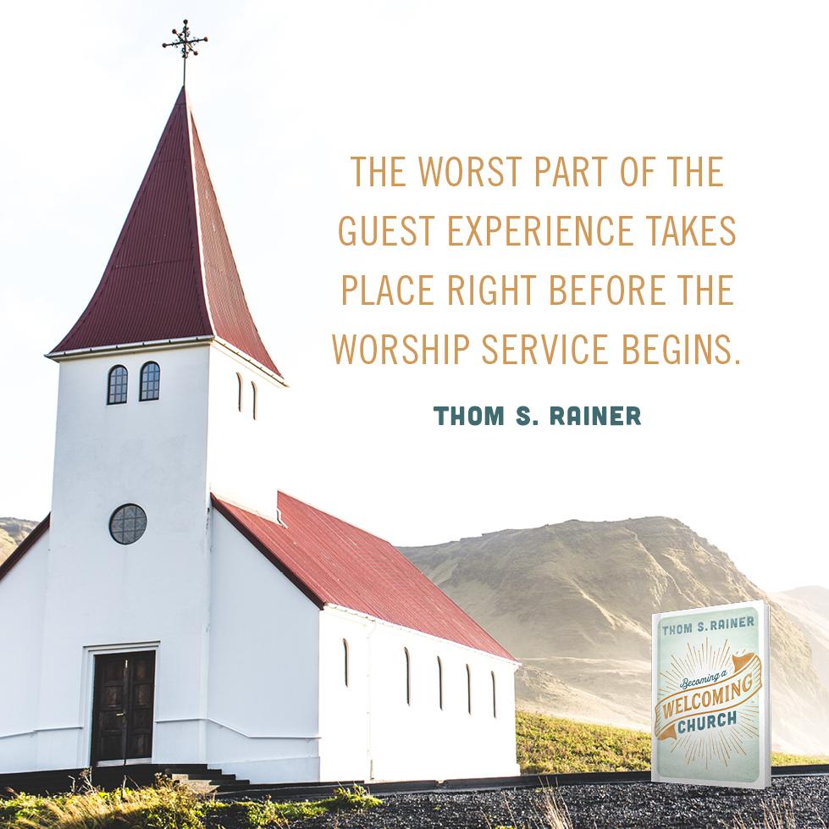

Slide 10
If you're not willing to extend God's peace, then take down your cross and be the social club you apparently are.

Slide 11
When someone new walks through the door of a church,
The first question is cultural: “Is there anyone here like me?”
The second question is personal: “Is there anyone here who is interested in me?”
The answer of the welcoming congregation is, “There are many like you. We welcome you no matter who you are.”

Slide 12
Visitors are people who attend a worship service or event at a church but are not likely to be regularly connected to the congregation (they live out of town, they have another church home, etc.). Remember, welcoming is not about growing your church, so visitors deserve special attention even if you never see them again.
Guests are people who attend worship or another event, perhaps at the personal invitation of someone from the church, who may reasonably be expected to return and get involved in the congregation. Those treated as “honored guests” are likely to return.
Newcomers are people who are relatively new to a congregation—not yet members, no longer first-time guests—interested in connecting with the church and its members. Newcomers are trying to find a way into the life and ministries of your church, so it’s important to remove barriers and serve their needs.

Slide 13
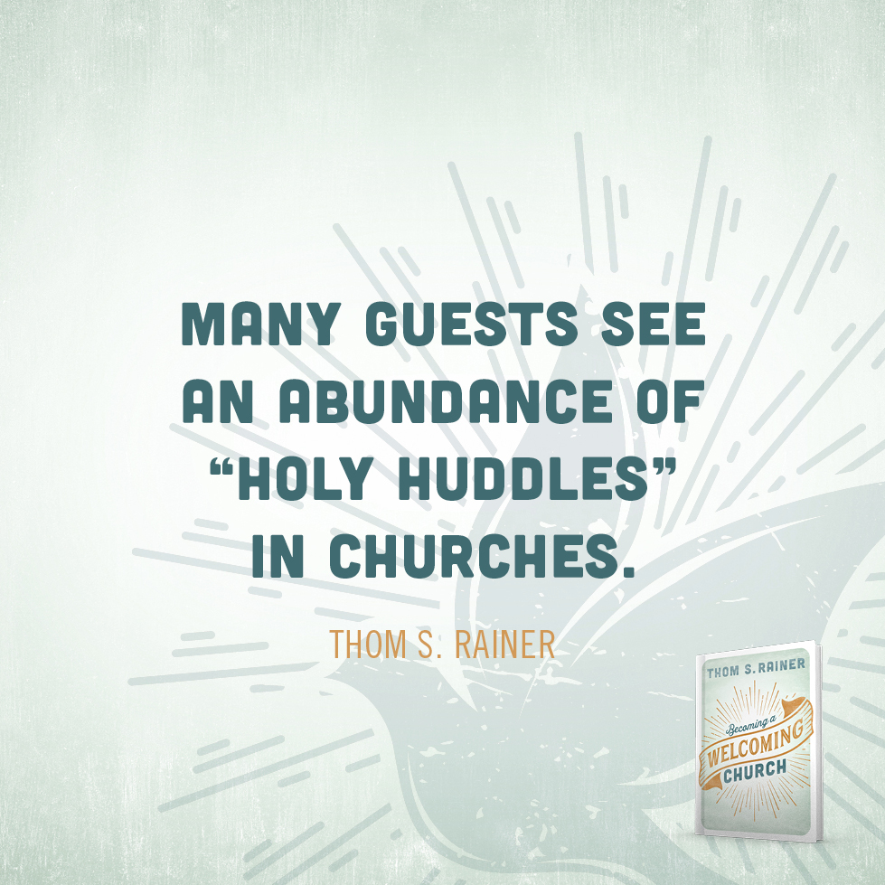

Slide 14
Welcome Team No No’s
  Getting caught up in lengthy conversations with people.
  Interrogating newcomers or keeping them too long at the doors, especially if your conversation keeps others outside.
  Leaving people hanging while waiting for an answer or assistance with a problem.
  Kissing and hugging; some people (regulars and newcomers alike) feel awkward about being touched in such a personal way by an acquaintance.
  Leaving your assignment unattended, especially close to the start of worship when newcomers are likely to arrive.

Slide 15
Body Language
It is very important that team members be attentive to the body language of those they are attending to. Some people appreciate a lot of attention, while others would rather be on their own. Be sensitive to the person’s demeanor and make a judgment call of how to make them feel comfortable.

Slide 16
Six ways to make people like you…
Become genuinely interested in other people.
Smile.
Remember the person's name.
Be a good listener. Encourage others to talk about themselves.
Talk in terms of the other person's interests.
Make the other person feel important - and do it sincerely.

Slide 17
Don’t know what to say to a visitor? Here are a few conversation starters:
Offer a handshake or fist bump, etc. and say, “Hello. My name is _____________, and you are ...?”
Wait for a response and repeat the person’s name so you make sure that you get it right and so you can more easily remember it.
If you think you know the face but can’t recall the name, try this approach:
“Hello, I’m ____________________. I believe I’ve seen you here before but I don’t know that we’ve had the opportunity to meet. What is your name?”
4.Don’t be embarrassed if you’re welcoming a member and don’t know that person’s name—or be offended if someone doesn’t remember yours. We need to offer grace to one another, just as we would to new people.

Slide 18
How to Not Lose Sight of Visitors
Four things leaders can do to help visitors feel at home….
Don’t worry about your own needs, but the needs of the visitor.
I can implement this into my role by…..
Choose hospitality over a quick greeting.
I can implement this into my role by…..
Recognize Sunday school as an initial contact point.
  I can implement this into my role by …..
Become a visitor for a day at a church in my community.
One thing I learned from this experience that I can implement is…

Slide 19
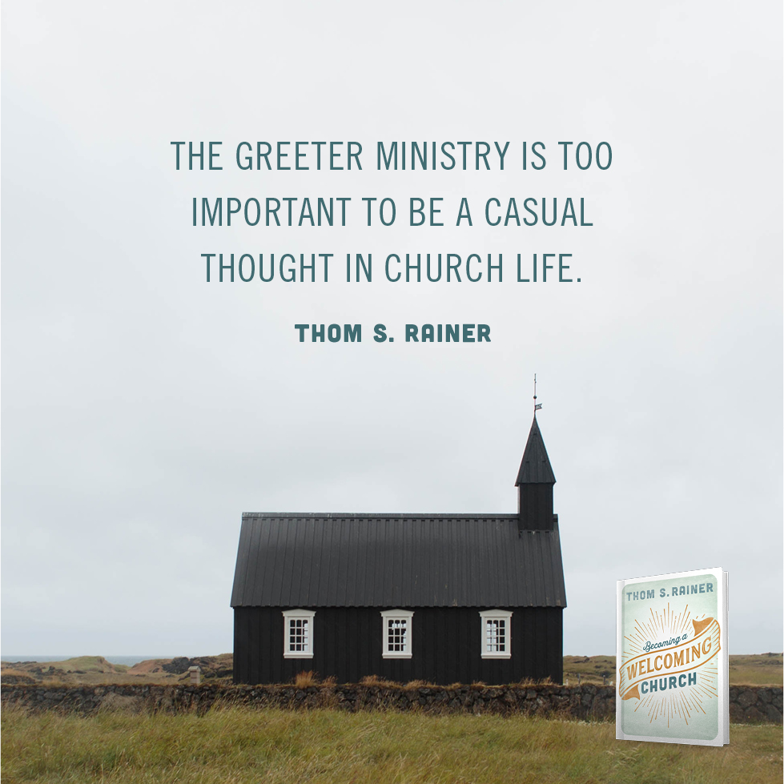

Slide 20


Best Buy’s C.A.R.E. Plus:
Contact (approach the customer)
Ask (engage the customer)
Recommend (suggest solutions or better alternatives)
Encourage (stroke the customer’s ego)
Fresh Start’s Visitor Philosophy:
1.
2.
3.
4.
5.

Slide 21
Fresh Start Sunday Morning Rules of Contact
Circle of 10: Greet anyone, member or guest, who comes within ten feet of you. Make a special effort to greet the people you don’t already know within your Circle of 10.
Rule of Three: Please do not talk to other members for the first three minutes after the service. Talk only to those you don’t know or people you know are guests. It takes guests about three minutes to exit the church after worship and we need to make sure someone has made contact with them before they leave.

Slide 22
Welcome Zones and Section Greeters

Slide 23
Welcome Ministry team members are responsible for:
• knowing the layout of the buildings and where activities are located
• being available in case of an emergency to help people to exits, etc.
• keeping the entrances clean and organized
• being on time and in their appropriate places
• securing an appropriate substitute in case of absence
• attending Group Prayer time at the designated time to pray for and encourage others
• demonstrating an servant-type attitude that is God-honoring
• opening the doors for incoming and outgoing members and guests
• making sure visitors receive a visitor information response card and collecting the card from them
• being aware and making themselves available to people needing special assistance
• being prepared and available to direct people and escort them when necessary
• keeping the entrances clean (picking up trash, placing "lost" items in the office, etc.)
• keeping traffic flowing through the entrances

Slide 24

Welcome Center, Handouts, and Location review

Slide 25
“Hospitality is less about what we do and more about who we are. As believers, we should make others feel at ease in our presence.”
- “Be Our Guest: Practicing Hospitality” by Jennifer McCaman

