Slide 1

Fresh Start Leadership Training
Ministry Planning

Slide 2


Slide 3
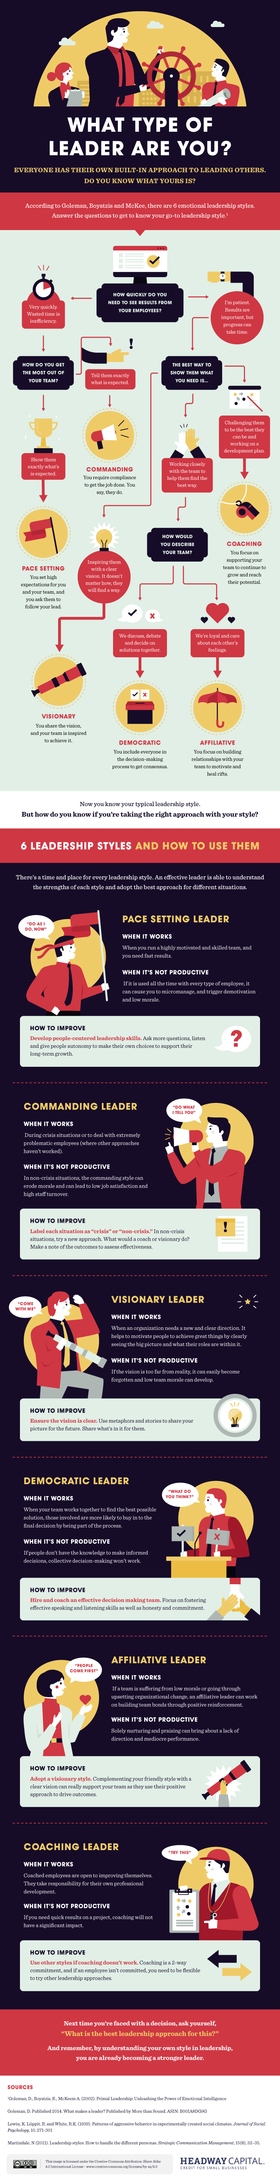

Slide 9
Planning helps an organization identify its goals. Preparing for the future allows leaders to consider the impact they would like the organization to have and to find a way to get there. When a team works together to set goals, it allows everyone to be on the same page, working toward a common, shared purpose.

Slide 10
https://www.youtube.com/watch?v=k9uM_6f5vmE

Slide 11


Slide 12
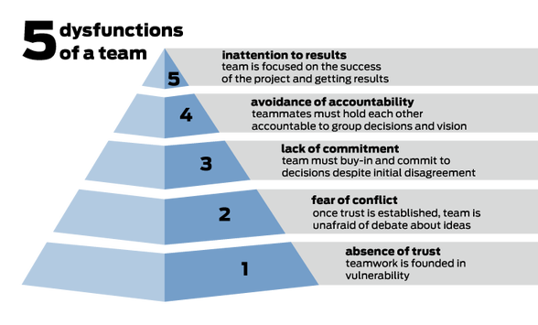

Slide 13
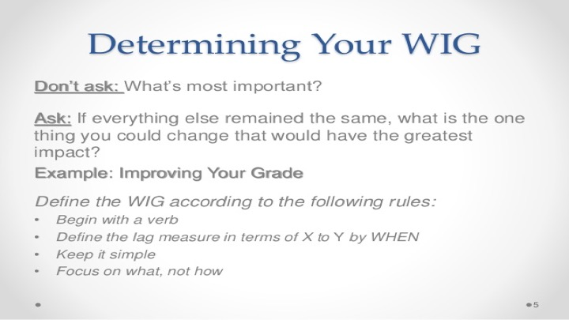

Slide 14
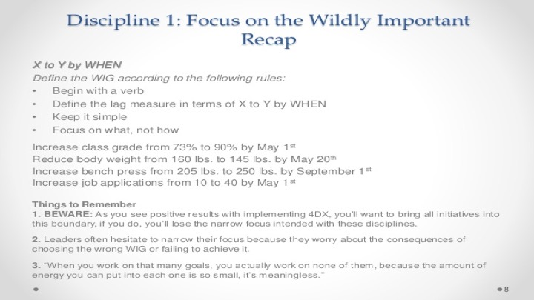

Slide 15
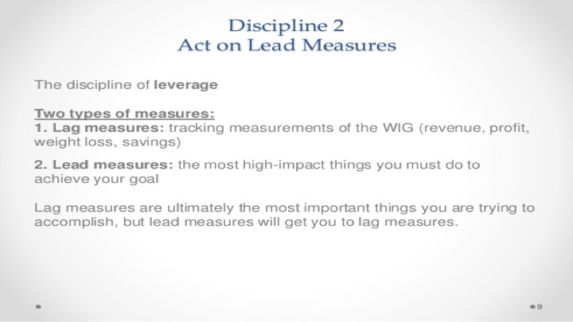

Slide 16
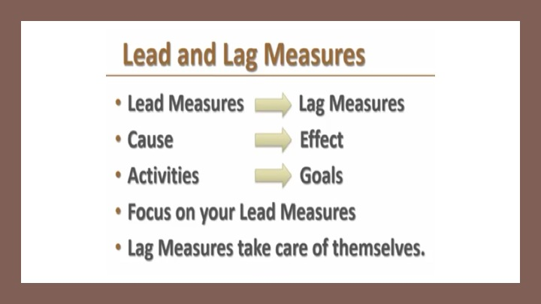

Slide 17
